Slide 1
Department of Physics and ASTRONOMY
Janice Thomaz

Slide 2
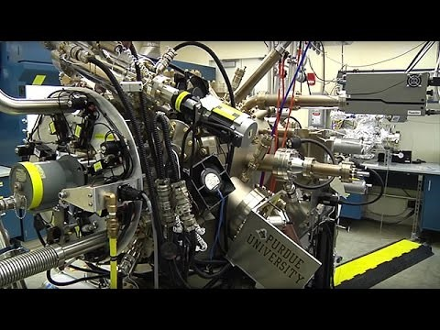
About the Department

Slide 3
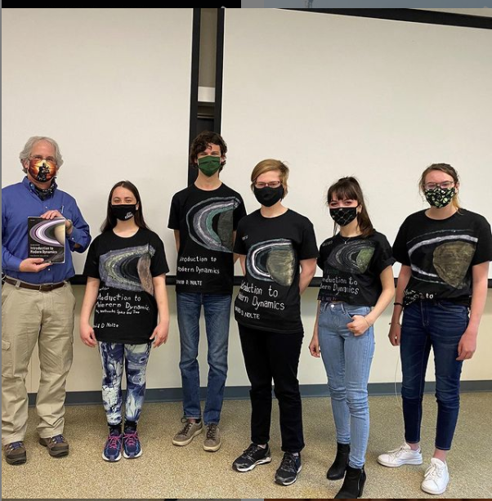
Physics Degree Requirements
University Core Curriculum (UCC)
Science Core (CoS core)
PHYS Major courses
Free Electives
120 total credits

Slide 4
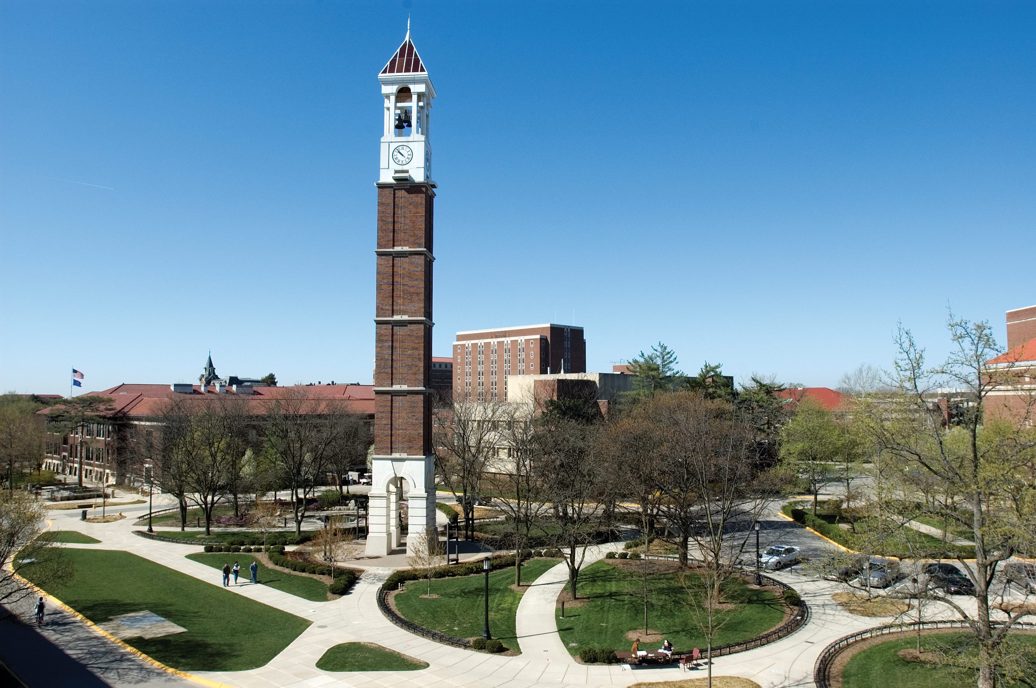
University Core Curriculum (UCC)
Foundational Outcomes
UCC-BSS Behavior/Social Science
UCC-HUM Humanities
UCC-IL Information Literacy
UCC-OC Oral Communication
UCC-QR Quantitative Reasoning
UCC-SCI Science
UCC-STS Science, Technology & Society
UCC-WC Written Communication

Slide 5
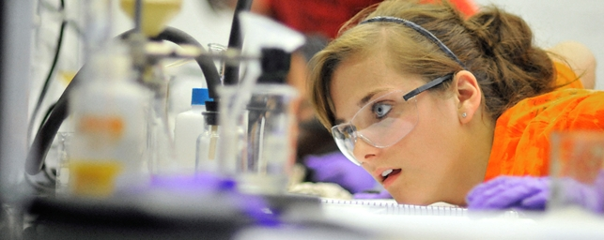
Science Core Requirements
College of Science
Composition & Presentation/UCC-OC +WC
Computing
General Education/UCC- BSS +HUM
Great Issues
Laboratory Science/UCC-SCI
Language & Culture/UCC-HUM
Mathematics (Calc I and II)/UCC-QR
Multidisciplinary Experience/UCC-STS
Statistics/UCC-IL
Teambuilding & Collaboration

Slide 6
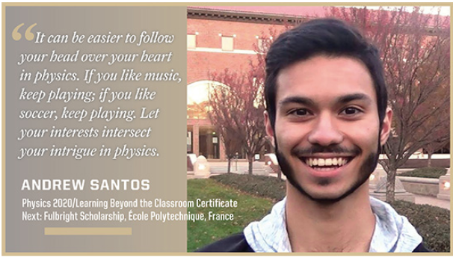
Physics Success Story

Slide 7
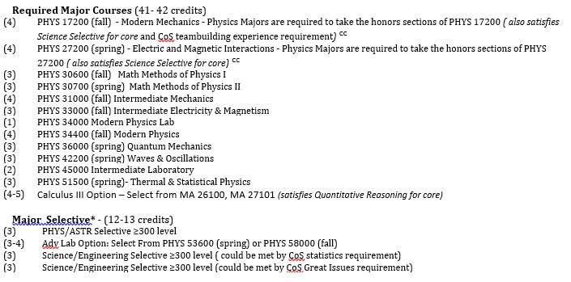
Physics Major Requirements
Subhead Acumin Pro Semi Cond Bold 22 pt
Bulleted copy. Acumin Pro Reg 18 pt. Keep it short with bite-size chunks of information.
Bulleted copy. Acumin Pro Reg 18 pt. Keep it short with bite-size chunks of information.
Bulleted copy. Acumin Pro Reg 18 pt. Keep it short with bite-size chunks of information.

Slide 8
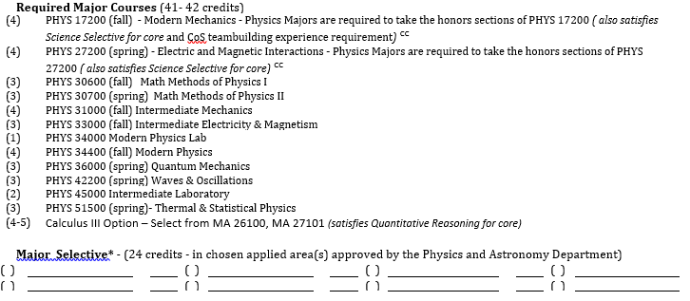
Applied Physics Major Requirements

Slide 9
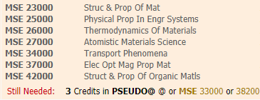
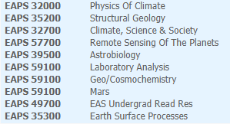
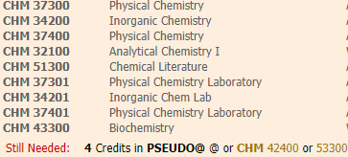
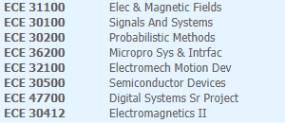
Applied Physics Selective – Examples
Selective in MSE
Selective in Planetary Sciences
Selective in Chemistry
Selective in ECE

Slide 10
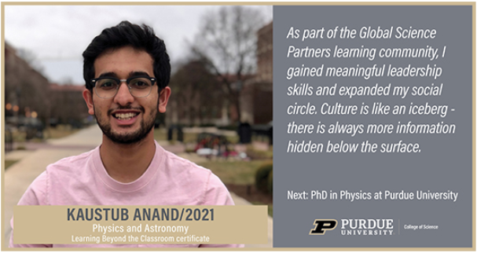
Degree Enhancements
Find Your Niche With Free Electives
Complete a minor
Astronomy
Computer Science
Mathematics
Complete a certificate
Learning Beyond The Classroom
Applications in Data Science
Entrepreneur & Innovation
Envrnmntl & Sustnblty Studies
Complete a double major
Mathematics
Planetary Sciences
Liberal Arts Degree+

Slide 11
High School Preparation
Challenge Yourself!
AP credits
IB credits
Dual Credits
https://www.admissions.purdue.edu/transfercredit/index.php
Successful FRESHMAN year in college
Fall 1st Year
PHYS 17200 – Modern Mechanics
CHM 11500 – General Chemistry
MA 16500 – Calculus I
ENGL 106 – First Year Composition
Spring 1st Year
PHYS 27200 – Electric and Magnetic Interactions
CHM 11600 – General Chemistry II
MA 16600 – Calculus II
General Education ( HIST, PHIL, ECON) or Foreign language and Culture

Slide 12
Physics Graduating Class Profile
Class of 2022 N= 44 students

Slide 13
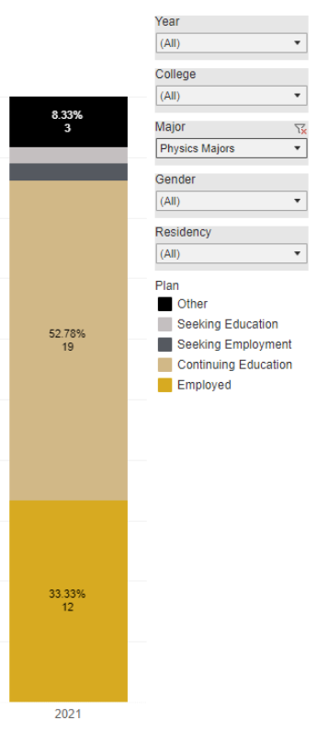
Where do Physics Graduates Go?
Physics Majors – 2022, N = 44
Physics Majors – 2021, N = 45

Slide 14

Undergraduate Research

Slide 15

Undergraduate Research
Jack Reynolds

Slide 16
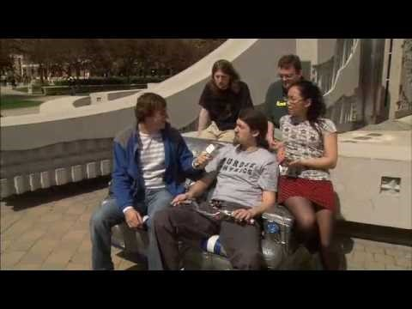
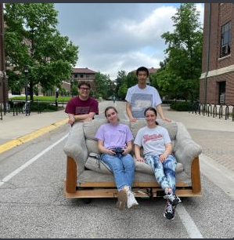
Physics Majors Having Fun
Start having fun with SMAP (Saturday Morning Astrophysics)
https://www.physics.purdue.edu/outreach/saturday-morning/index.html
Dates: Selected Saturdays, announced monthly
Times: 11:00 AM Eastern
Format: Live on Zoom / YouTube Live

Slide 17
Thank You
Questions???
Janice
Email: thomazj@purdue.edu

